Slide 2
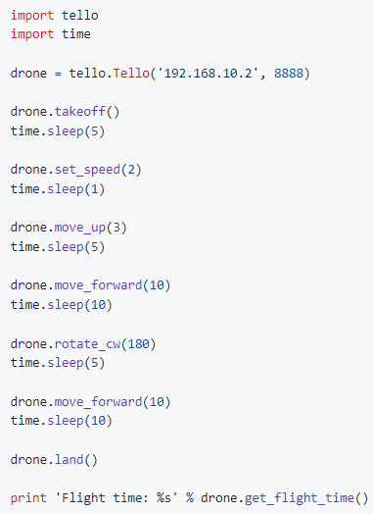
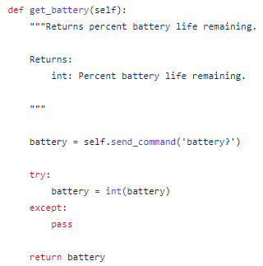
Python Basic Structure
import package
*from djitellopy import tello
defined functions
def get_battery(self):
main codes

Slide 3
Required packages
To install a package:
Go to terminal: pip install [package name] / pip3 install []
For conda users:
Go to conda terminal: conda install [package name] / pip install []
List installed packages: pip list
List of needed packages:
time, opencv-python, numpy, djitellopy, pygame.

Slide 4
Connect to a tello
To connect to a tello, the most simple way is:
[Define a variable for drone obj] =
[Retrieve ‘tello’ class from package]tello.[Call ‘Tello’ method]Tello()
e.g. Drone = tello.Tello()
Drone.connect()
To further specify more params:
Drone = tello.Tello('192.168.10.2', 8889)
where local ip and port could be manually changed.

Slide 5
Capture the video of a tello
To activate the camera, by using the obj pre-connected:
activate ‘streamon’ > setup camera window display > read frame
# initiation
Drone.streamon()
time.sleep([seconds])
Pygame.init()
# create capture
cap = cv2.VideoCapture(0)
Camera_Width = 720 Camera_Height = 480 xThreshold = 90 yThreshold = 60 ColorThresh = 80 Linecolor = 'black'
#create read loop
while True:
frame = Drone.get_frame_Read()
cv2.imshow(‘Frame’, frame)
# Exit button
if cv2.waitKey(1) & 0xFF == ord(‘q’)
break
cap.release()
cap.destroyAllWindows()

Slide 6
Call other tello parameters
get_battery()
get_flight_time()
get_height()
get_pitch()
get_roll()
get_speed_x() \ get_speed_y() \ get_speed_z()

Slide 7
Movement control
takeoff()
rotate_clockwise(x) / rotate_counter_clockwise(x)
move([up, down, left, right, forward or back], [cm])
move_up(x) / move_down(x) / move_forward(x) / move_backward(x) / move_left(x) / move_right(x)
send_rc_control(left_right_velocity, forward_backward_velocity, up_down_velocity, yaw_velocity)
land()

Slide 8
Mission pads
enable_mission_pads() / disable_mission_pads()
get_mission_pad_id()
get_mission_pad_distance_x() / get_mission_pad_distance_y() / get_mission_pad_distance_z()

Slide 9
Trace tracking of tello

Slide 10
Distance measure using camera

